Slide 1
Capstone 1
SpringBoard First Project

Slide 2
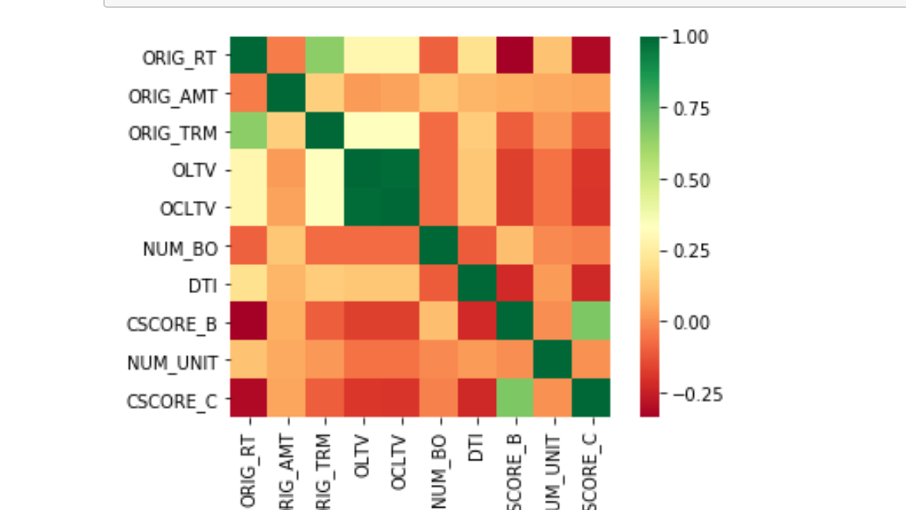
Correlation matrix Heat map

Slide 3
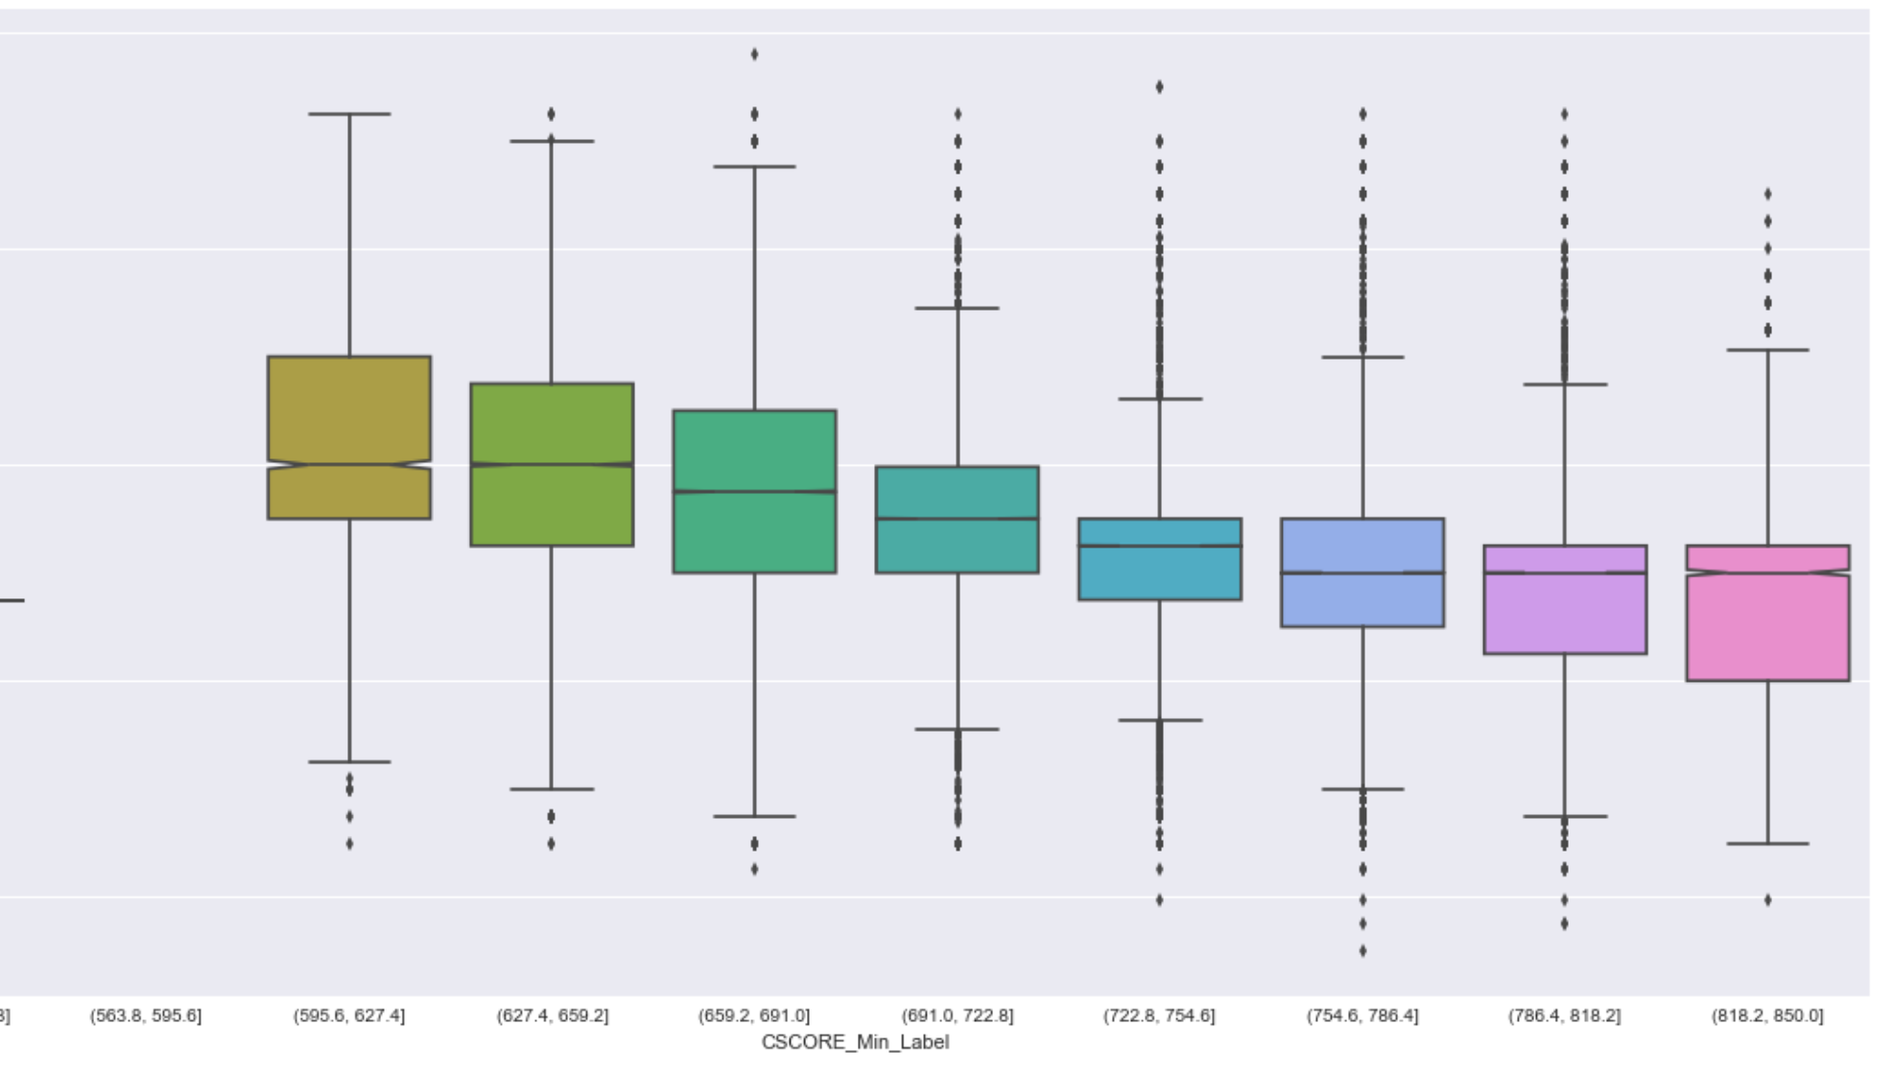
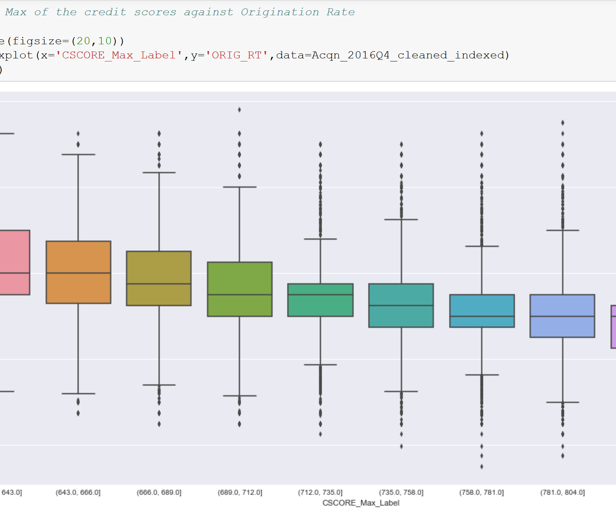
Credit scores and Interest Rates trend

Slide 4
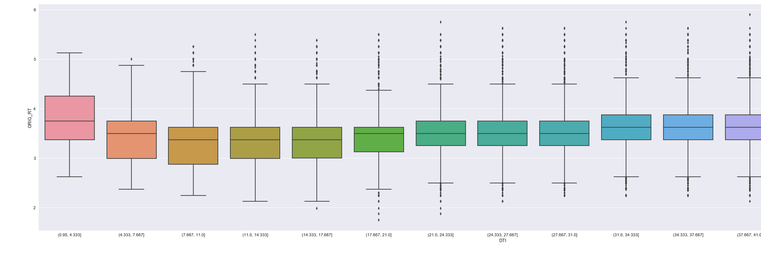
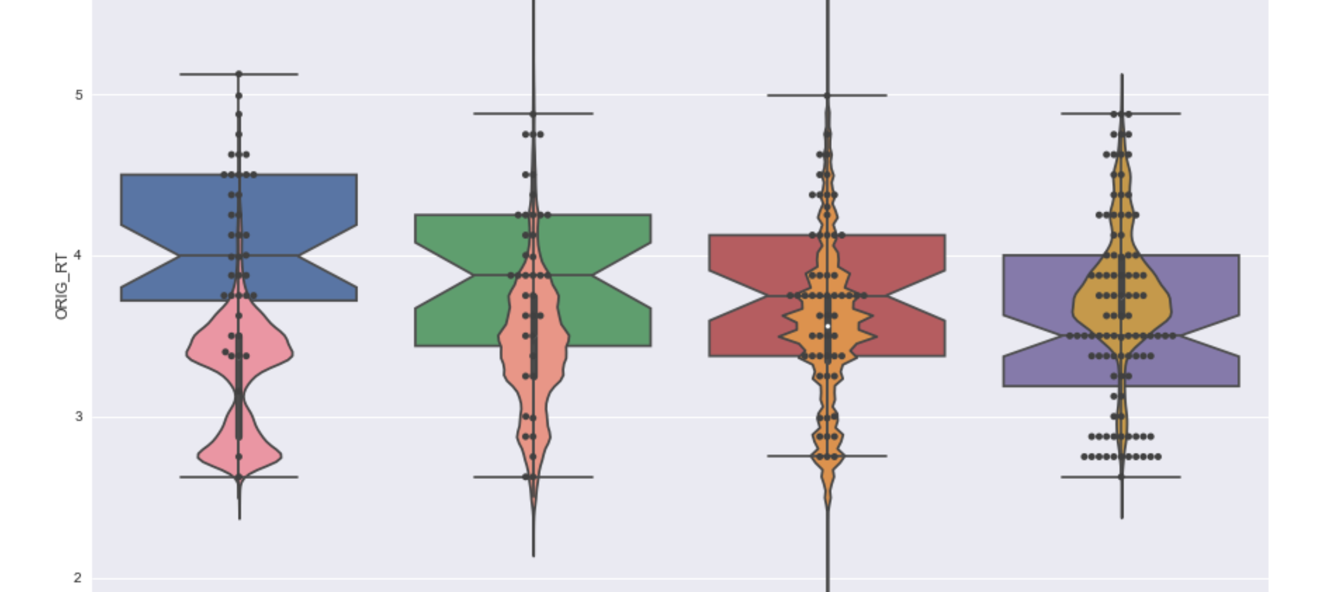
DTI(Debt to Income Ratio) Vs Origination Rates

Slide 5
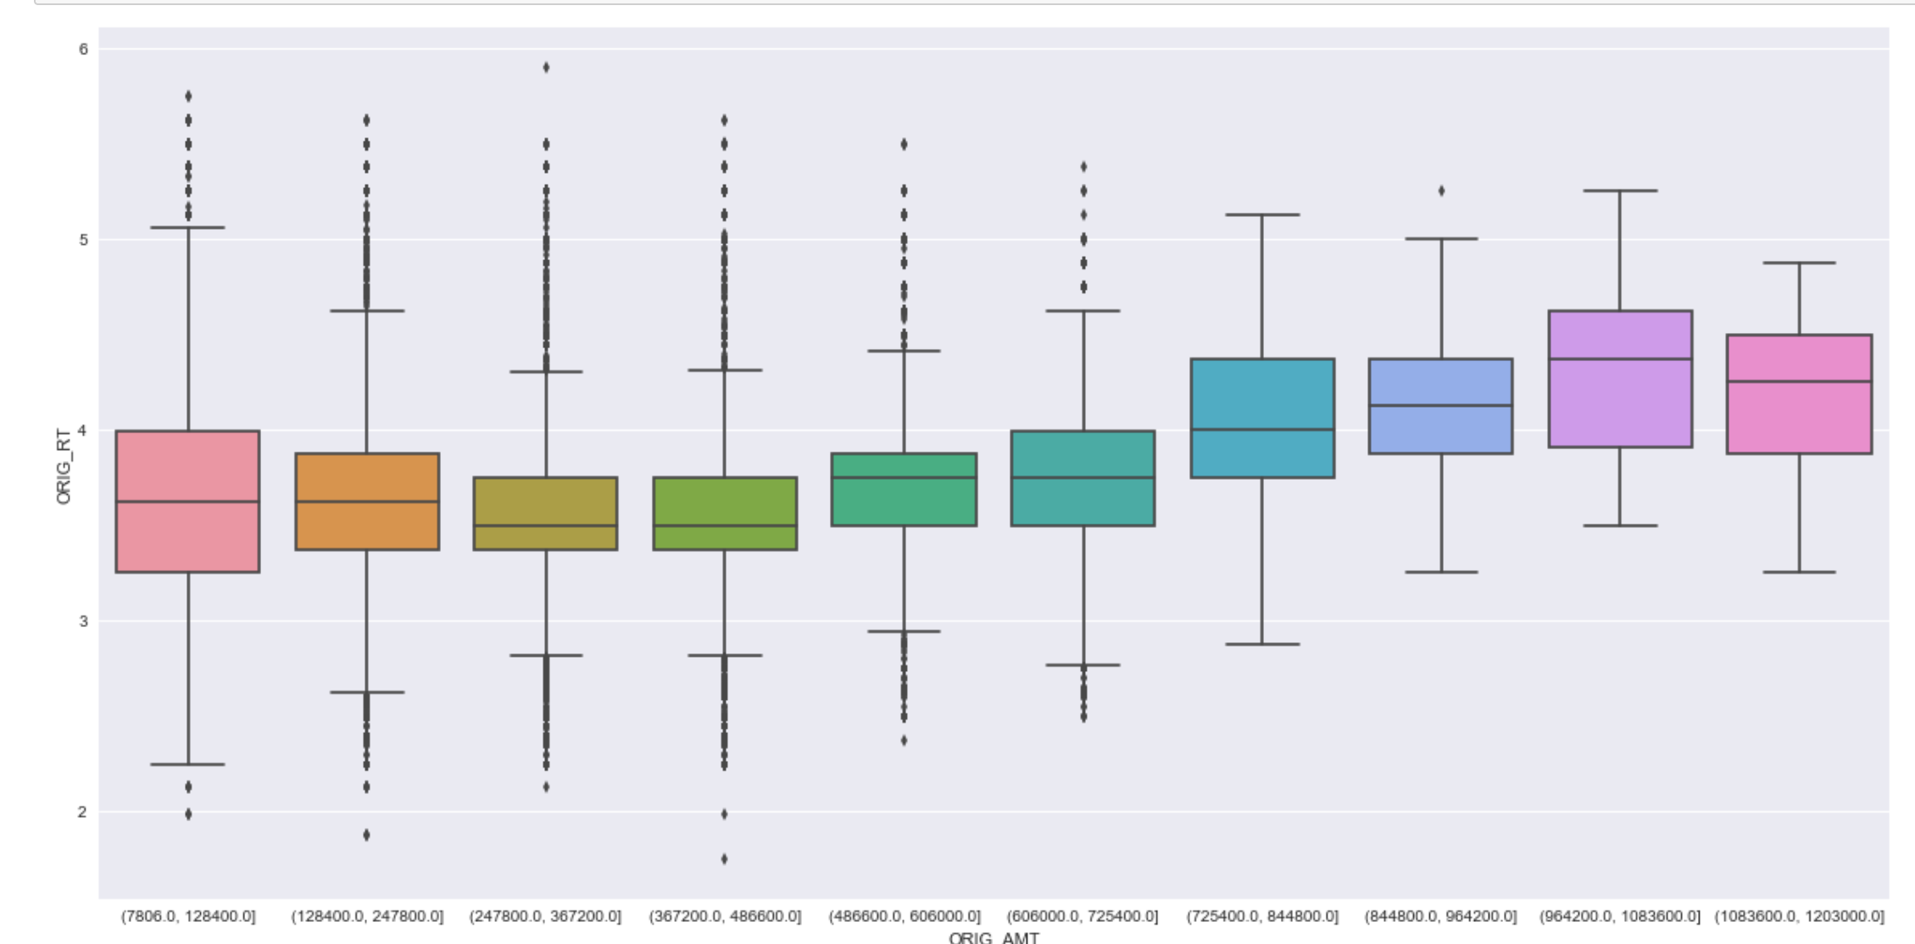
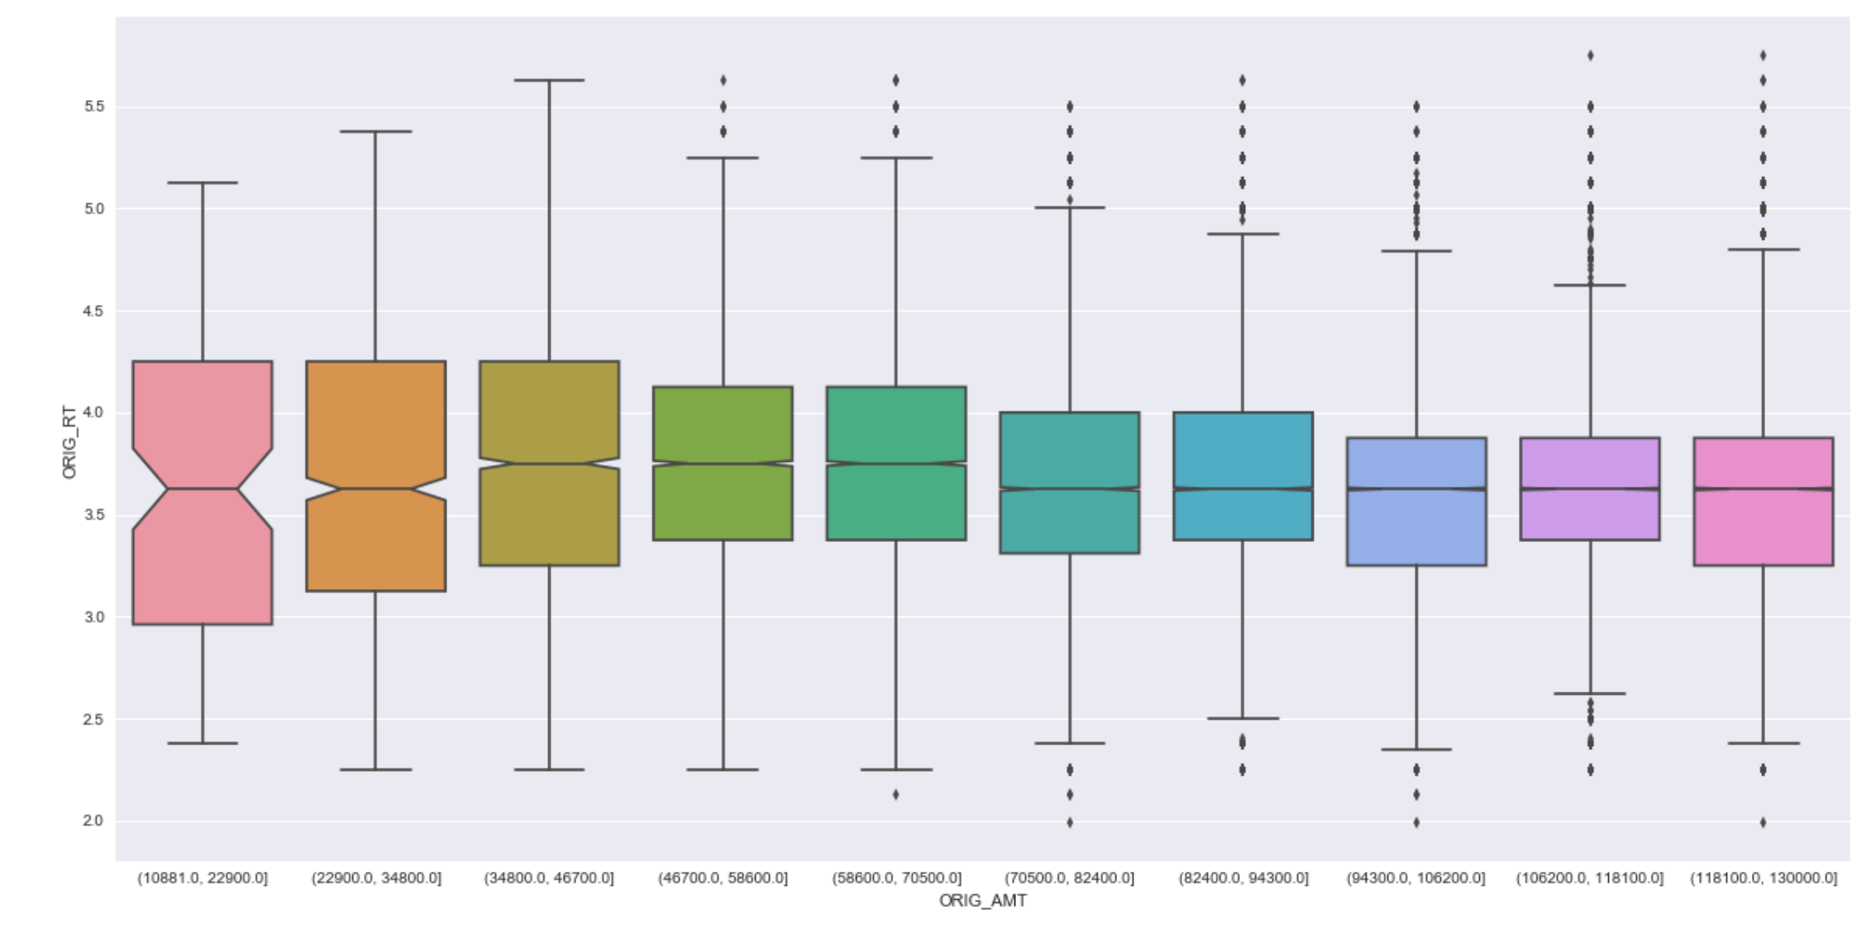
Origination Amounts Vs Origination Rates

Slide 6
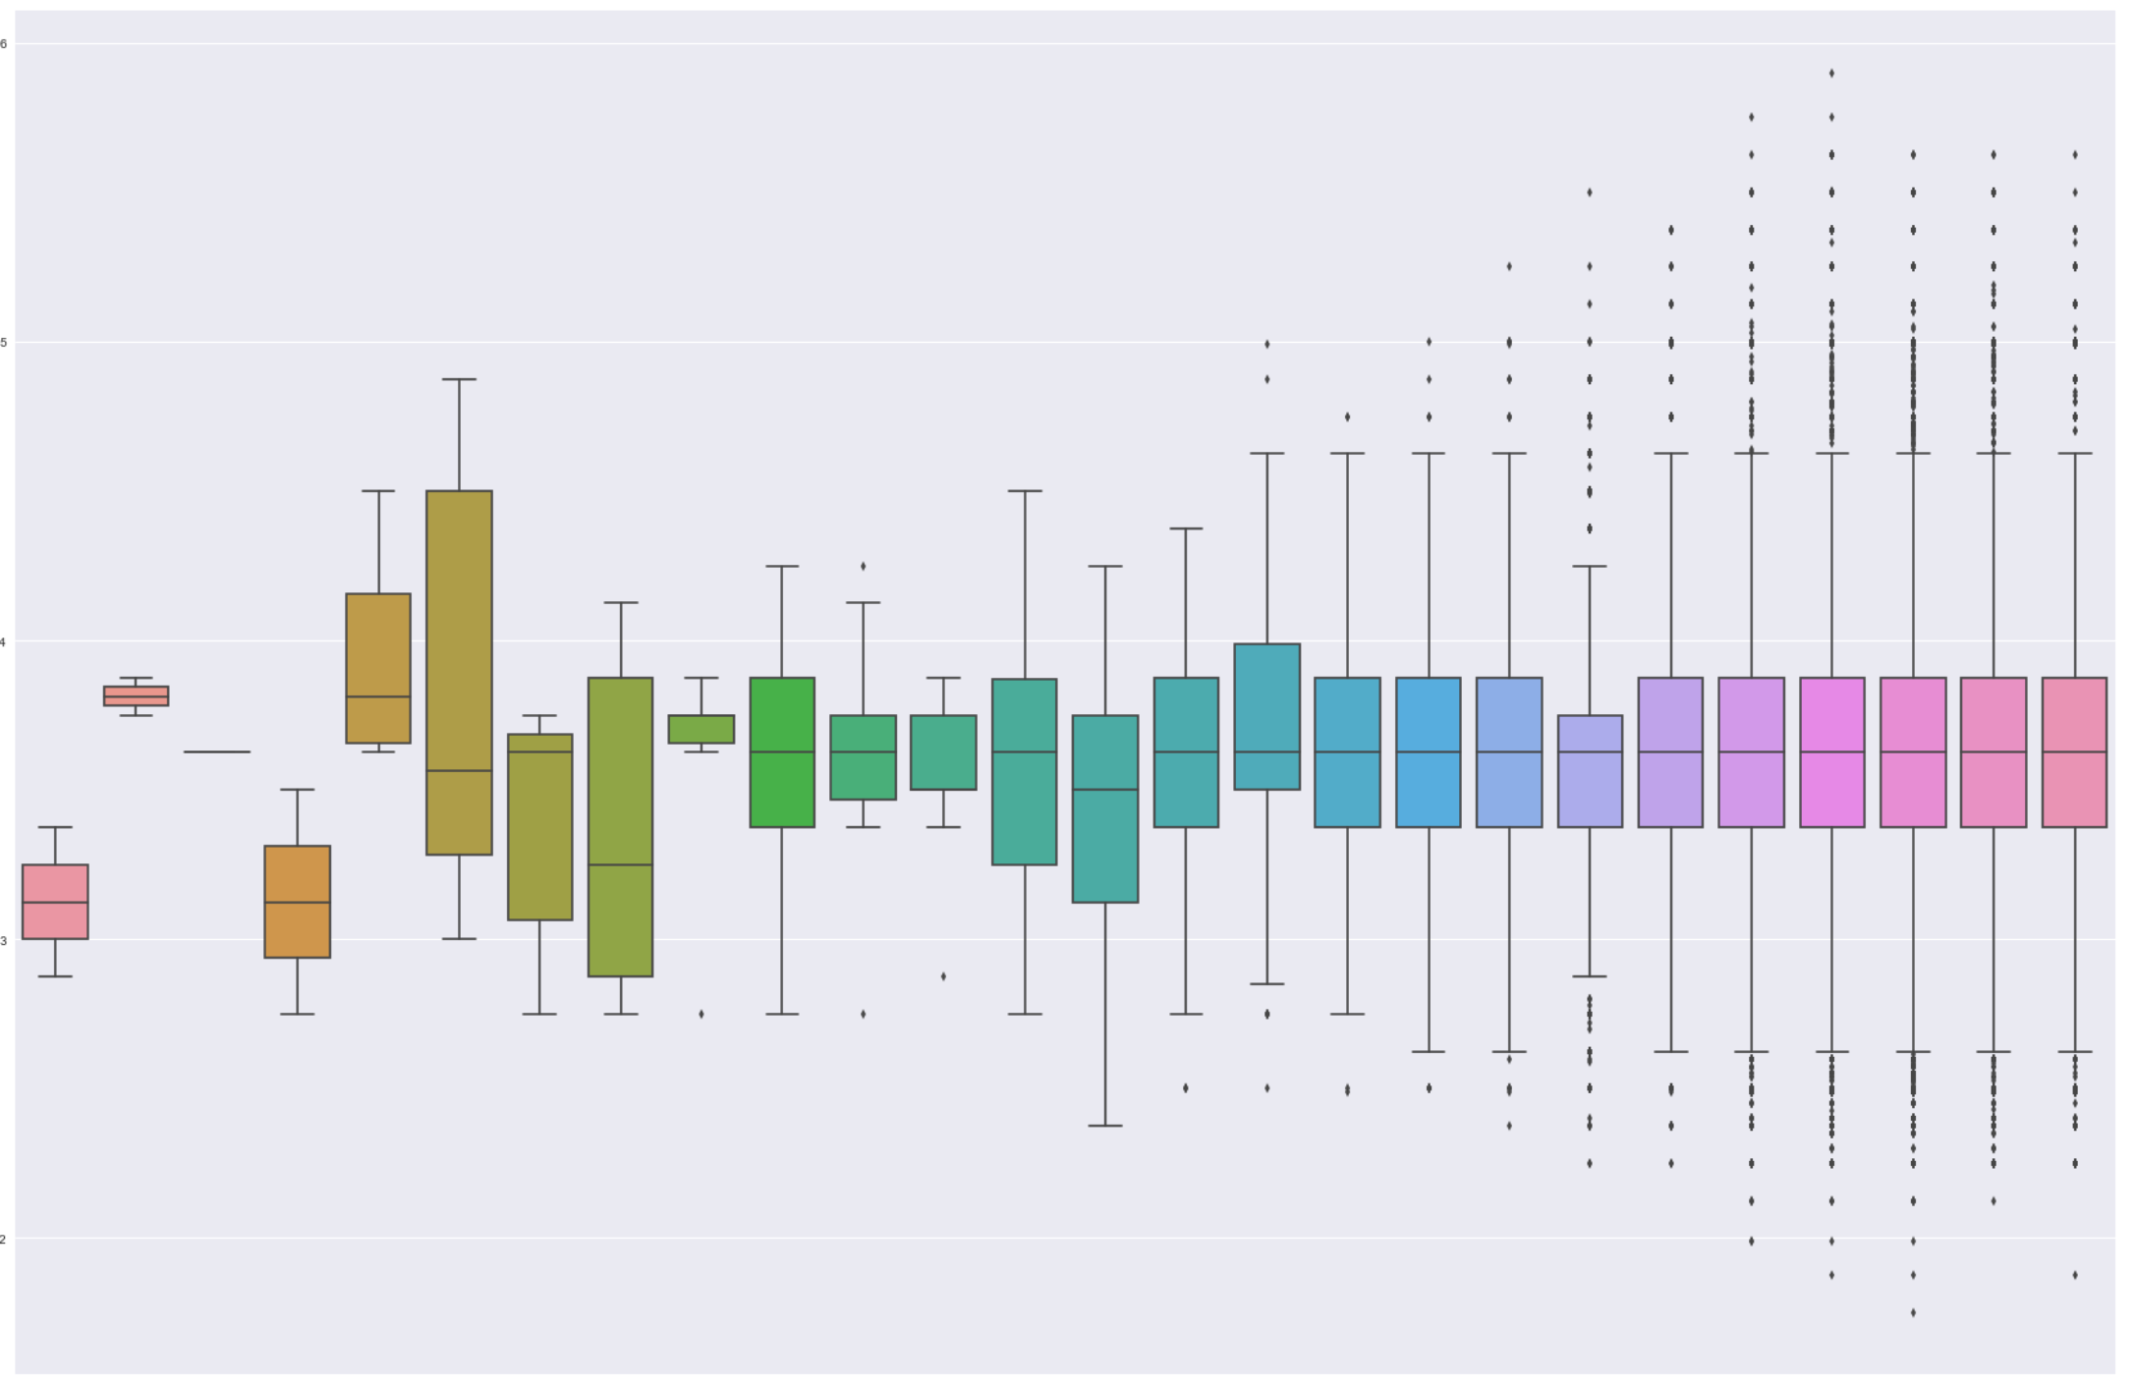
Orig Month Vs Orig Rate

Slide 7
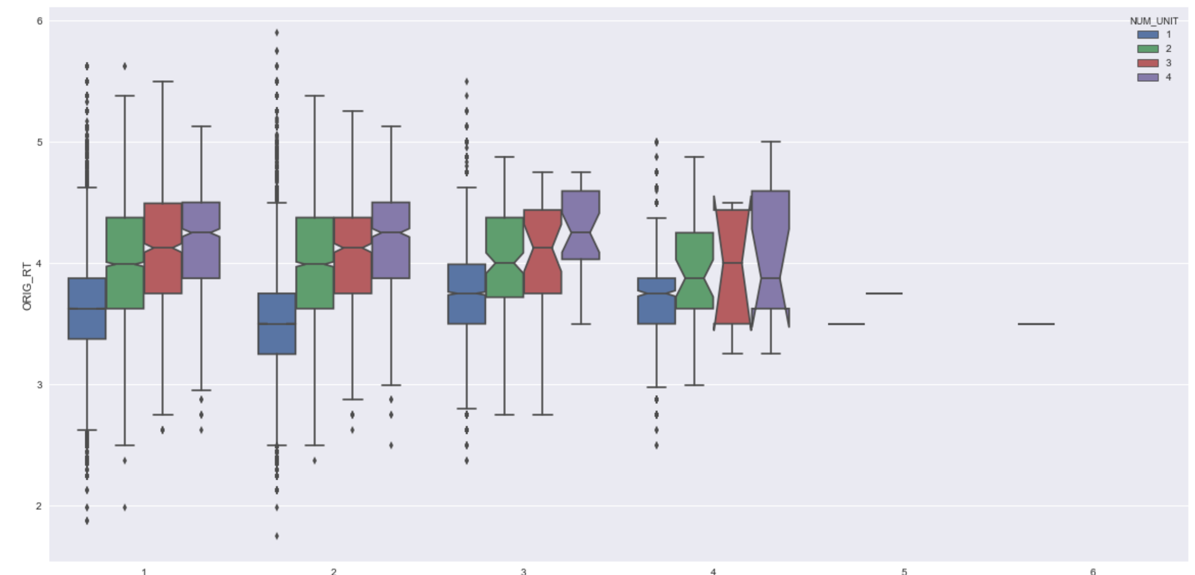
Num of Borrowers Vs Orig Rt

Slide 8
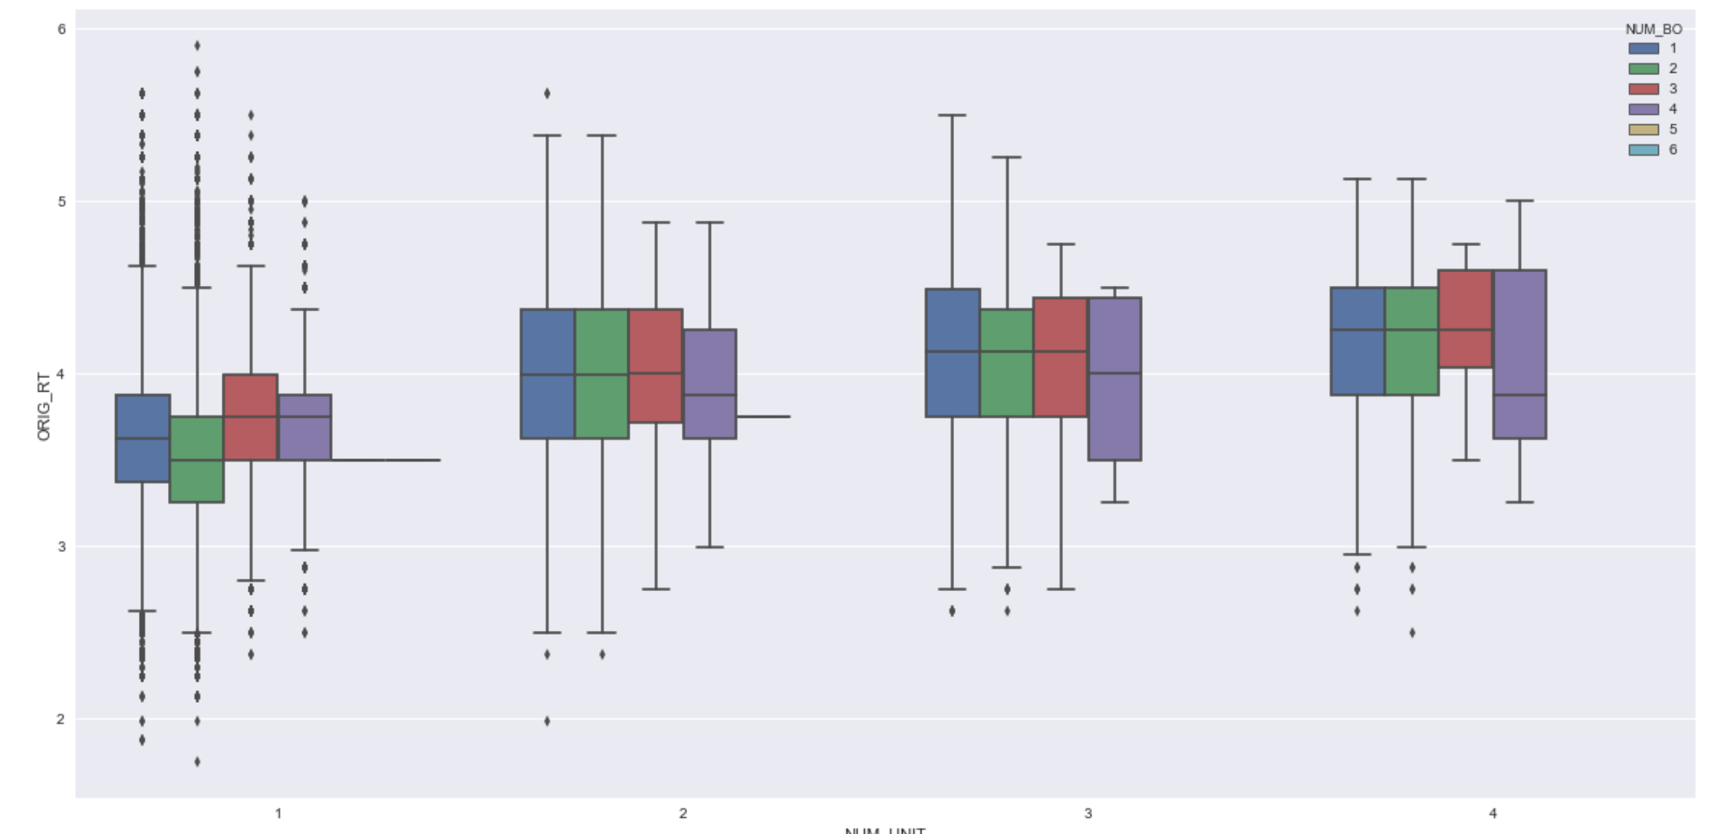
Num of Units Vs Orig Rt

Slide 9
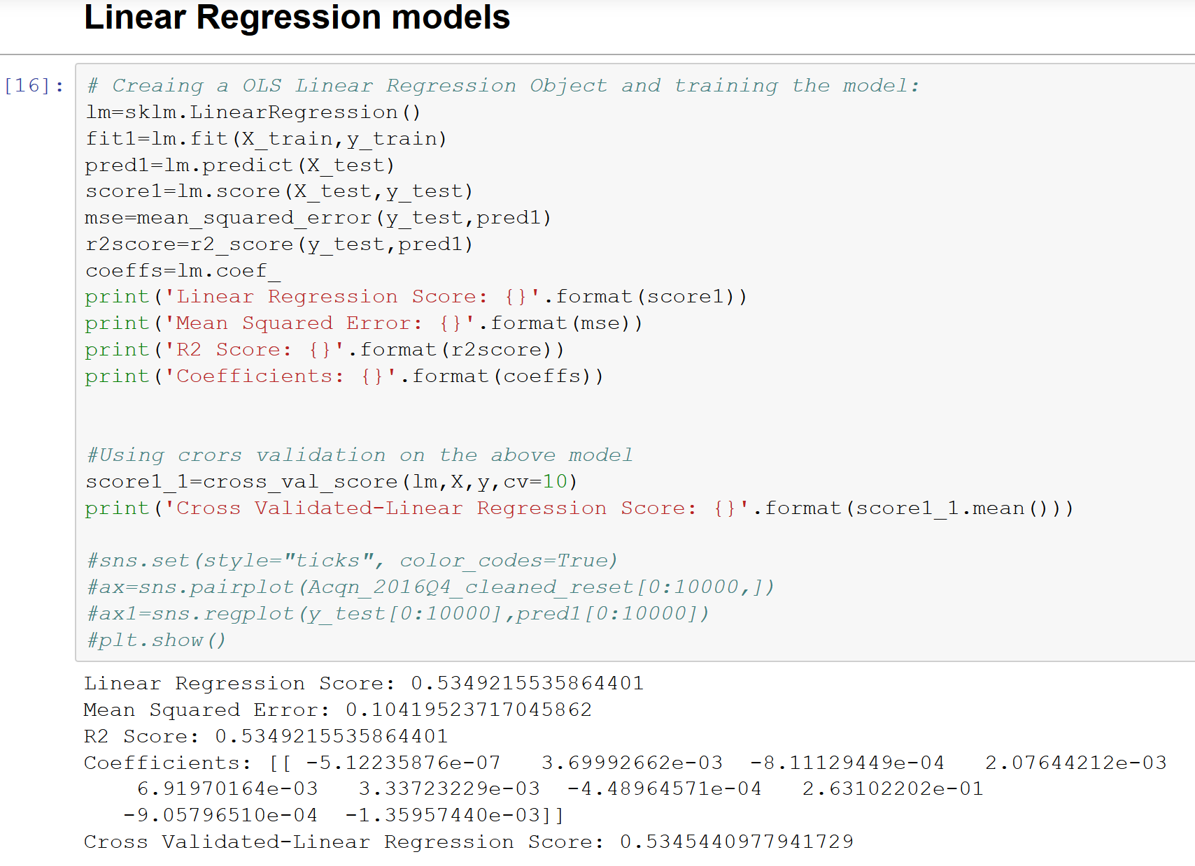
Linear Regression Models
OLS Regression Model

Slide 10
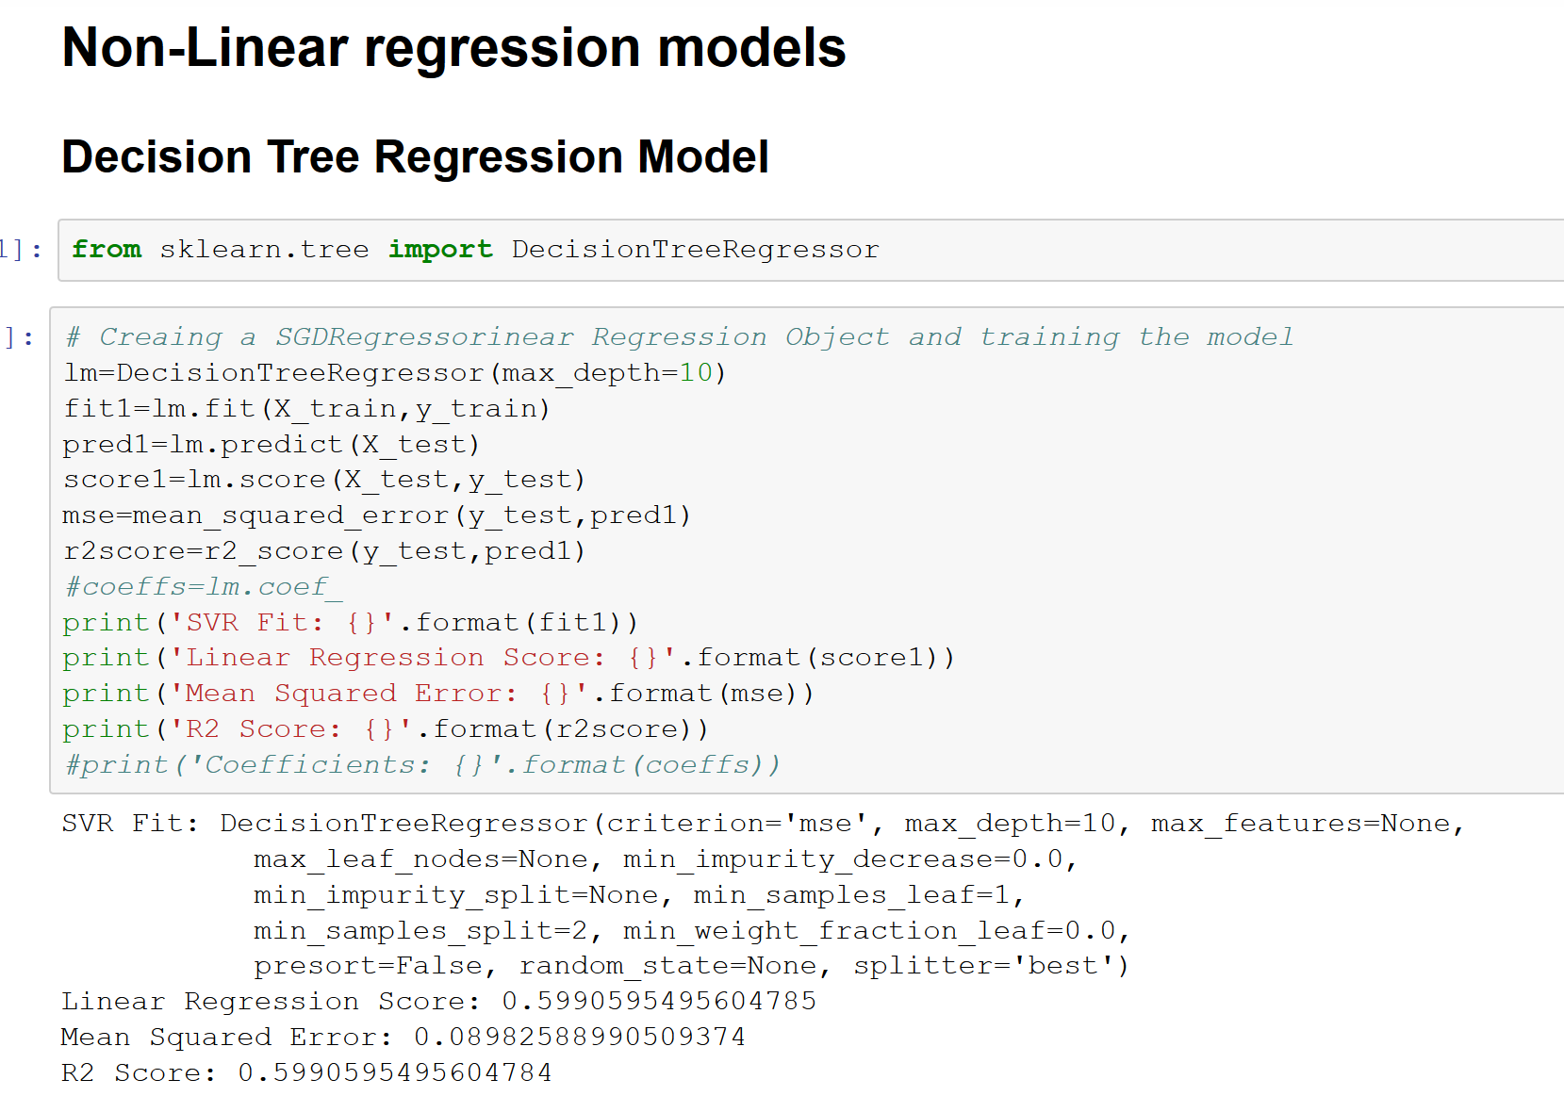
Non Linear Regression Models
Decision Tree Regression Model

Slide 11
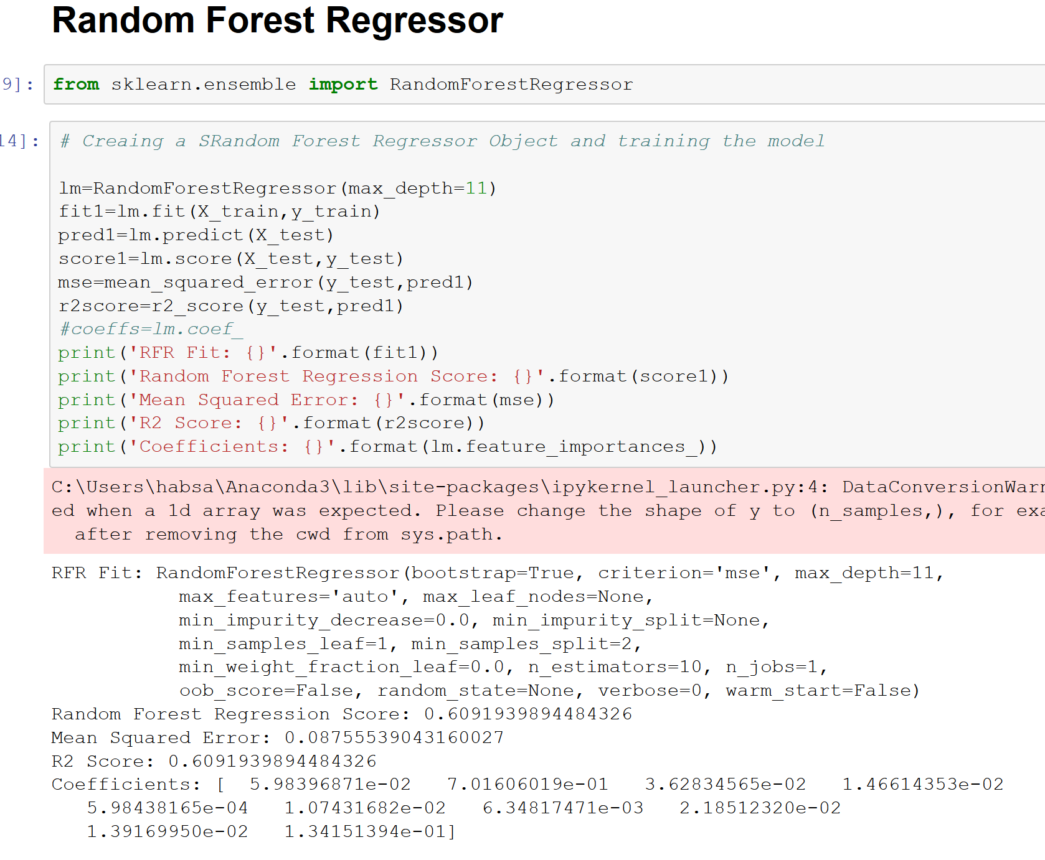
Non Linear Regression Models
Random Forest Regressor

Slide 12
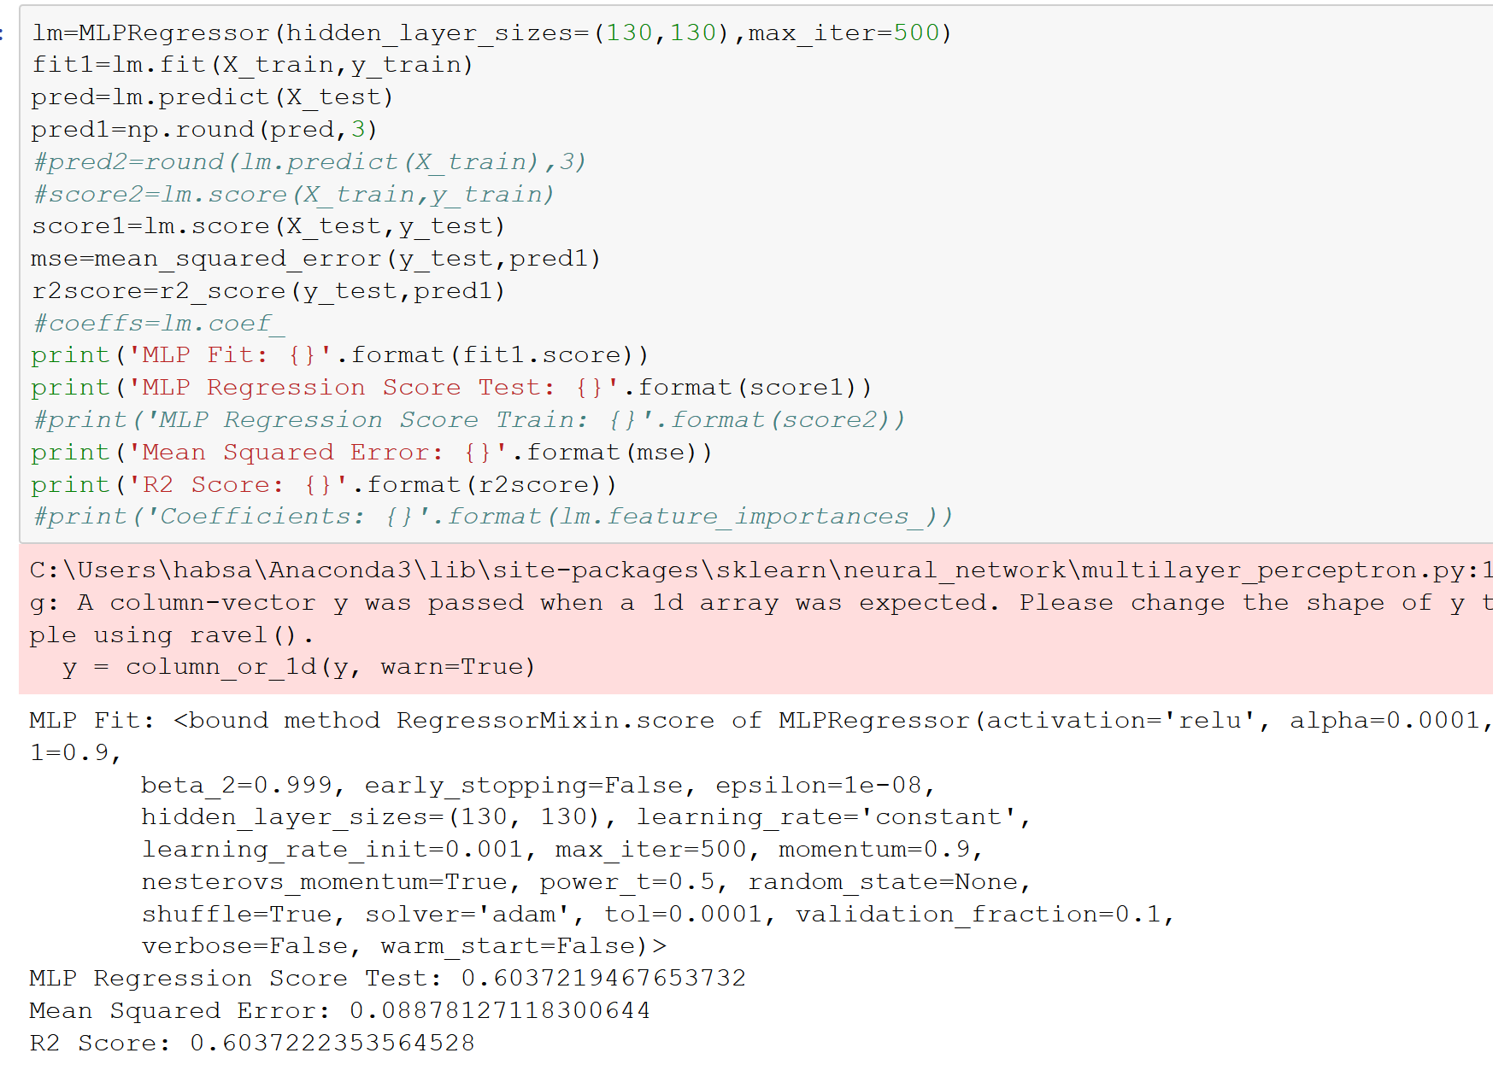
Non Linear Regression Models
Nueral Networks Regression Model (MLP Regressor)

